Slide 1

Mini Project Synopsis Presentation
on
Comparative Study and Implementation of FFM, HM and MBTI model using ML
Md. Monirul Islam (Reg. No. 202000237)
Phirat Passi (Reg. No. 202000553)
Sourav Dutta (Reg. No. 202000402)
Under the guidance of:
Mrs. Minakshi Roy
Assistant Professor (SG)
DEPARTMENT OF COMPUTER SCIENCE AND ENGINEERING
SIKKIM MANIPAL INSTITUTE OF TECHNOLOGY
(A constituent college of Sikkim Manipal University)
MAJITAR, RANGPO, EAST SIKKIM – 737136

Slide 2

CONTENTS
Sl. No. | Title | Page No.
1. | Abstract | 3
2. | Introduction | 4
3. | Literature survey | 8
4. | Problem definition | 9
5. | Solution strategy | 10
6. | Design | 11
7. | Gantt Chart | 12
8. | References | 13

Slide 3
1. ABSTRACT
Many students are known to encounter uncertainty about their career choices and the marketability of the interests they own and wish to pursue.
Due to the availability of numerous domains in the evolving world, the complexity of the issue is increasing.
Personality determining models such as Five factor model, Holland’s Model and MBTI model are used.
The aim of this project is to implement the Personality behavioral traits using the above mentioned three standard models.

Slide 4
2. INTRODUCTION
Predictive analytics is a branch of advanced analytics that makes predictions about future outcome using historical data combined with statistical modelling, data mining techniques and machine learning.
Nowadays predictive analytics is used in personality assessment of human’s behavioral traits.
The three prominent models like Five factor, Holland and MBTI are used for assessing a person’s qualitative attributes which leads to career prediction.
We also aim to make a comparative study among the three mentioned prediction models.

Slide 5
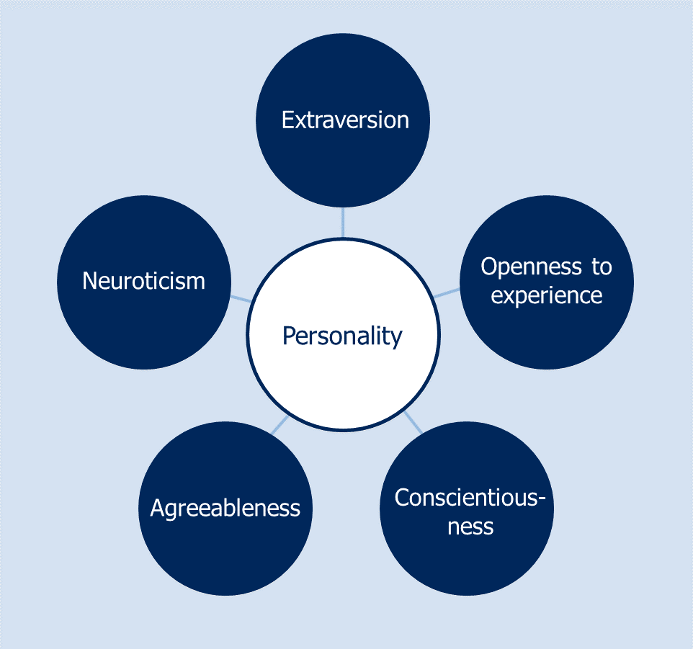
2. INTRODUCTION
Five factor model

Slide 6
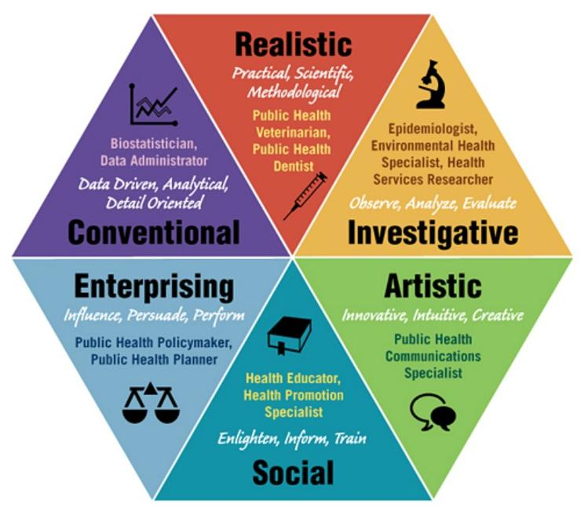
2. INTRODUCTION
Holland’s Theory

Slide 7
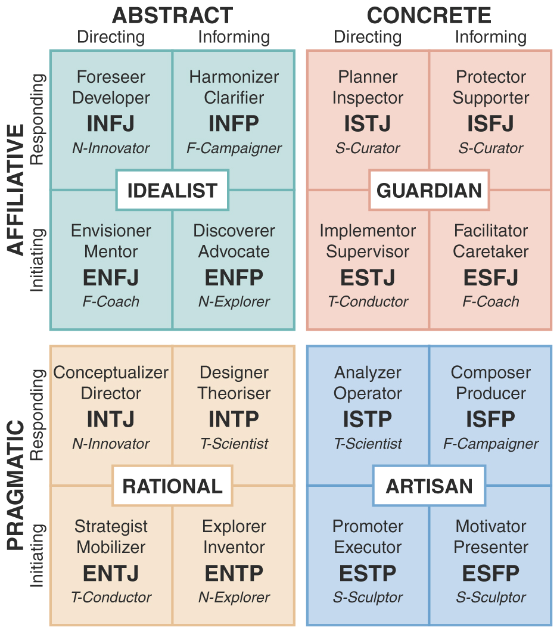
2. INTRODUCTION
MBTI Model

Slide 8

3. LITERATURE SURVEY
Sl No | Author(s) | Paper and Publication Details | Findings | Relevance to the Project
1 | Dileep Chaudhary, Harsh Prajapati, Rajan Rathod, Parth Patel, Rajiv Kumar Gurjwar | Student Future Prediction Using Machine Learning | Regression, Linear Regression, Decision Tree Regression, Random Forest Algorithm | It will help to predict the suitable course and facilitate students to take appropriate decision
2 | Pratiyush Guleria, Manu Sood | Explainable Ai and machine learning: performance evaluation and explainability of classifiers on educational data mining inspired career counselling | Decision Tree, Support Vector Machine and Logistic Regression | It will guide students to decide appropriate career according to their capabilities
3 | Prof. Priyanka Shahane, Prutha Rinke, Taniksha Datar, Soham Badjate | Student’s Career Interest Prediction using Machine Learning | Decision Tree, Support Vector Machine, One Hot Encoding, XG Boost | It will assist them with self-improvement and motivation to make the right choice
4 | Chelsea Song, Hyun Joo Shin, Chen Tang, Alexis Hanna, Tara Behrend | Investigating machine learning’s capacity to enhance the prediction of career choices | RAISEC(Holland), K-th Nearest Neighbour, Elastic Net, Random Forest | It will enhance the accuracy of interest inventory-based career choice prediction
5 | Abhishek S Rao, Bola Sunil Kamath, Ramya R, Shreya Chowdhury, Shreya A Pattan, Raveena Krishna Kundar | Neural network in developing a personality prediction model for career guidance: A Boon for Career | Artificial Neural Network, K-Folds cross-validation | It will try to learn the personality of a person and predict a suitable career goal using ANN

Slide 9
4. PROBLEM DEFINITION
Currently various models are available for assessing a person’s behavioral traits (qualitative attributes), so it is tough to find the appropriate model which gives better accuracy.
Choosing a career can be a quite daunting task for a learner as per their personality (behavioral traits)
Career counselling is challenging task which is done by expert career counsellors, and we completely rely on their expertise. However, humans are prone to errors and biases.

Slide 10
5. SOLUTION STRATEGY
Data Collection: It is the systematic approach to gathering and measuring information from a variety of sources to get a complete and accurate picture of an area of interest.
Data preprocessing : It describes any type of processing performed on raw data to prepare it for another processing procedure.
Assessing the attributes: It will qualitatively analyze the learner’s attributes.
Statistical Inference: It helps us to make predictions from the data
Implementation of model: Models such as Five factor, Holland and MBTI are used
Testing: The trained model is tested against the remaining dataset

Slide 11
6. DESIGN
Start
Five factor model , Holland’s model ,MBTI model
Using standard questionnaire
Collection of data from the target audience through questionnaire
Implementation of prediction model
Testing and Comparing the results using 3 models
Data pre-processing (Data cleansing , data transformation , reduction etc)
Stop
Data set source:
1.Kaggle datasets
2.Google datasets
3.Data. World
Assessing qualitative attributes of the learner
Performing Statistical inference

Slide 12
7. GANTT CHART
ACTIVITY | TIME FRAME
 | Jan-23 |  |  |  | Feb-23 |  |  |  | Mar-23 |  |  |  | Apr-23 |  |  |  | May-23
Literature Survey
Problem Definition
Design and Development
Testing and Validation
Documentation
 | Proposed activity
 | Achieved activity
 | Ongoing activity
Notes:
12

Slide 13
8. REFERENCES
[1] Chaudhary, Dileep, et al. "Student future prediction using machine learning." International Journal of Scientific Research in Computer Science, Engineering and Information Technology 5.2 (2019): 2456-3307
[2] Guleria, Pratiyush, and Manu Sood. "Explainable AI and machine learning: performance evaluation and explainability of classifiers on educational data mining inspired career counseling." Education and Information Technologies (2022): 1-36.
[3] Rao, Abhishek S., et al. "Use of artificial neural network in developing a personality prediction model for career guidance: A boon for career counselors." International Journal of Control and Automation 13.4 (2020): 391-400.
[4] Song, Q. Chelsea, et al. "Investigating machine learning's capacity to enhance the prediction of career choices." Personnel Psychology (2022).
[5] Zainudin, Zaida Nor, et al. "The relationship of holland theory in career decision making: A systematic review of literature." Journal of Critical Reviews 7.9 (2020): 884-892.

Slide 14
THANK YOU

